Slide 1
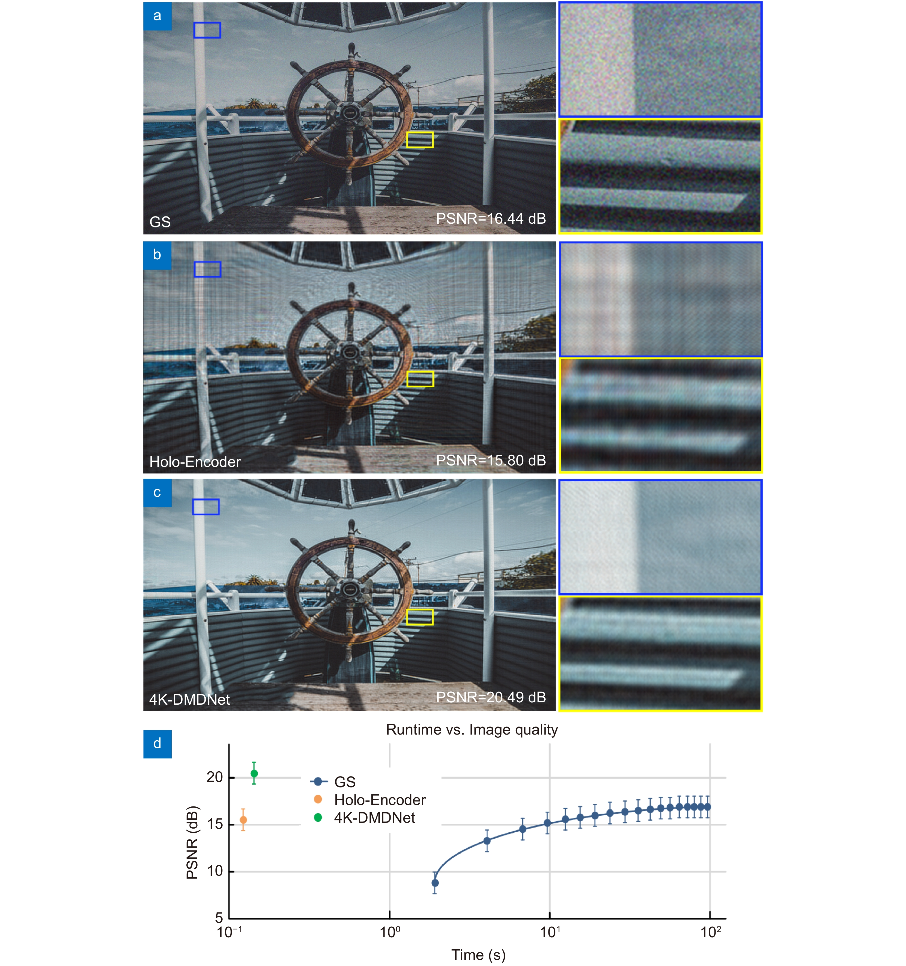
Figure 6. Contrast between the numerical simulations of POHs by (a) the GS algorithm, (b) Holo-Encoder, and (c) 4K-DMDNet. (d) Evaluation of algorithm runtime and image quality. The length of the bar represents the standard deviation of 100 samples (DIV2K_valid_HR).
Kexuan Liu,Jiachen Wu,Zehao He,Liangcai Cao
4K-DMDNet: diffraction model-driven network for 4K computer-generated holography
https://doi.org/10.29026/oea.2023.220135

